Slide 1

Foot Traffic and Dwell Time Trends at Office Supply Stores During the Remote Work Shift
Analyzing visitor behavior changes amid remote work trends
Notes:
AI-generated content may be incorrect. ---

Slide 2
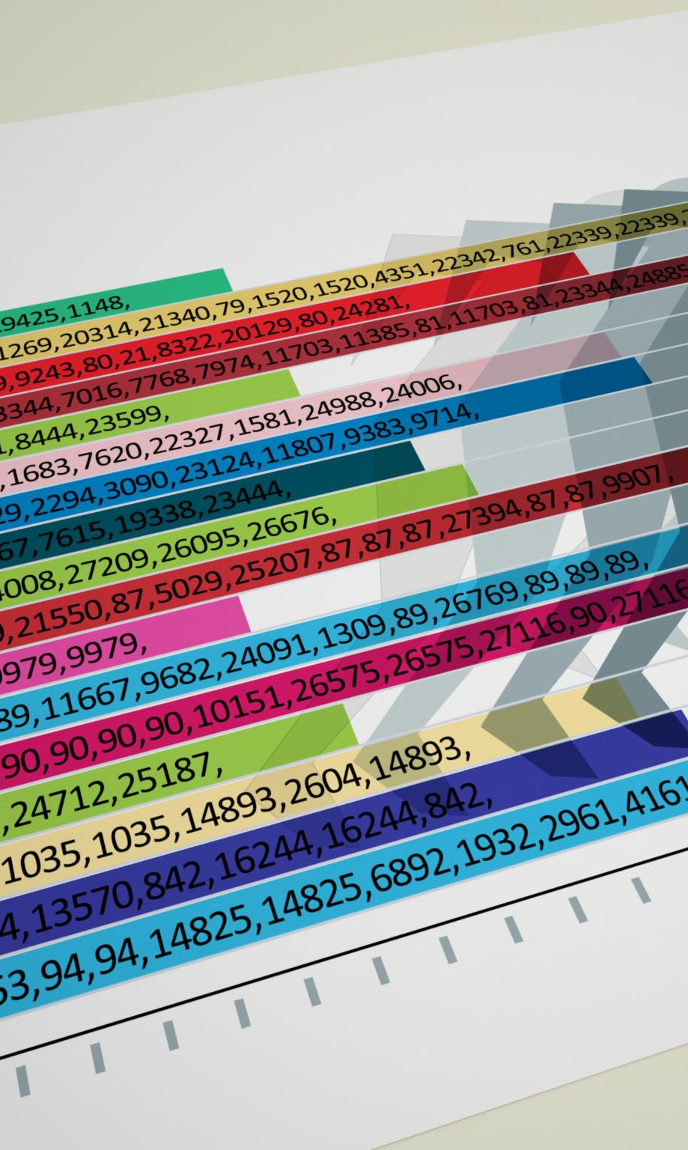
Research Questions & Context
Foot Traffic and Dwell Time Trends
Examines weekly changes in store visits and time spent during the first four months of 2020 amid remote work transitions.
Urban vs Suburban Visit Patterns
Analyzes whether suburban counties saw stronger increases in visits compared to urban centers during the remote work shift.
Brand Stability and Consumer Loyalty
Studies how certain office supply brands stabilized faster in visits and dwell times indicating brand loyalty and essential purchasing.
Data Sources and Demographics
Utilizes SafeGraph data, RUCA codes, and demographic variables to contextualize consumer behavior and intent.
Notes:
--- This slide references information from the following file: https://purdue0-my.sharepoint.com/personal/rsana_purdue_edu/_layouts/15/Doc.aspx?sourcedoc=%7BCB5F538E-AD73-4F91-A8F8-8F5817F554D1%7D&file=Group%207_Status_Report%20copy_deck%20reference.docx&action=default&mobileredirect=true This study investigates how consumer behavior shifted in response to the remote work transition during the early months of the COVID-19 pandemic, focusing on office supply stores in California. The analysis centers on three key research questions: First, how did foot traffic and dwell times evolve week by week during the first four months of 2020? Second, did suburban counties experience a stronger rise in visits compared to urban centers during the remote work shift? Third, did certain office supply brands stabilize faster in terms of visits and dwell times, and what does this suggest about brand loyalty and essential purchasing behavior? The study uses data from SafeGraph to track foot traffic and dwell time, RUCA codes to classify counties as urban, suburban, or rural, and demographic data including education levels, working-age population, and K–12 households. These variables help contextualize consumer intent and engagement patterns. The research is particularly relevant for understanding how different geographic and demographic segments responded to the sudden need for home-office supplies, and how these responses shaped retail dynamics in the office supply sector.

Slide 3
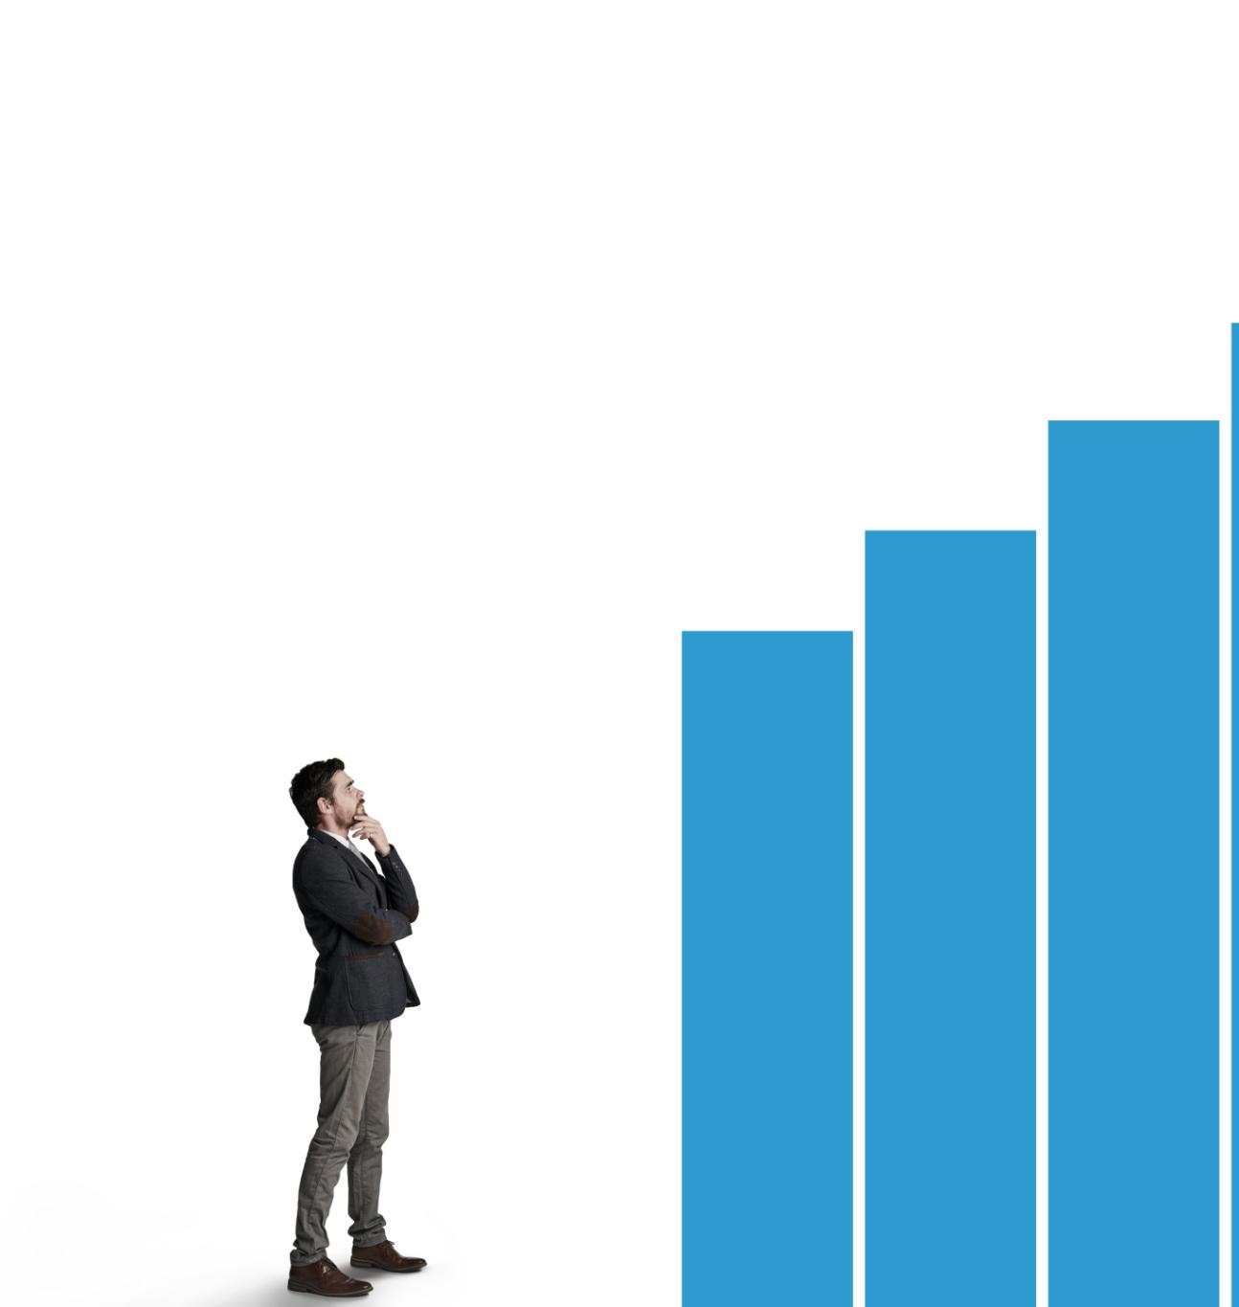
Methodology
Data Sources and Classification
The study integrates SafeGraph foot traffic data and 2020 RUCA codes to classify urban, suburban, and rural counties.
Demographic Influences
Demographic factors like education levels, working-age population, and household density influence store visits and engagement.
Trend Analysis and Correlations
Weekly foot traffic and dwell time trends from January to April 2020 reveal brand recovery and correlations with demographics.
Notes:
--- This slide references information from the following file: https://purdue0-my.sharepoint.com/personal/rsana_purdue_edu/_layouts/15/Doc.aspx?sourcedoc=%7BCB5F538E-AD73-4F91-A8F8-8F5817F554D1%7D&file=Group%207_Status_Report%20copy_deck%20reference.docx&action=default&mobileredirect=true The methodology employed in this study integrates multiple datasets to analyze consumer behavior at office supply stores during the remote work shift. The primary data source is SafeGraph, which provides detailed foot traffic and dwell time metrics for various retail brands. To classify counties into urban, suburban, and rural categories, the study uses the 2020 Rural-Urban Commuting Area (RUCA) codes. Additionally, demographic data such as education levels, working-age population (ages 18–64), and K–12 household density are incorporated to understand the influence of these factors on store visits and engagement. The analytical approach involves tracking weekly trends in foot traffic and dwell time from January to April 2020. Brand-level comparisons are made to identify which retailers experienced faster recovery and stabilization. Correlation analyses are conducted to examine how demographic indicators relate to consumer behavior, such as whether higher education levels are associated with longer dwell times or whether suburban areas saw quicker rebounds in store visits. This multi-dimensional methodology allows for a nuanced understanding of how different consumer segments responded to the pandemic-induced shift to remote work.

Slide 4

Key Findings
Dominant Brands and Foot Traffic
Staples and Office Depot led in foot traffic, with Staples rebounding fastest by Week 17, reflecting strong brand loyalty.
Specialty Stores and Dwell Time
Specialty stores like Papyrus and Rapid Refill had fewer visitors but longer dwell times, indicating focused, high-intent purchases.
Suburban vs Urban Engagement
Suburban counties showed highest engagement and fastest recovery; urban areas had slightly fewer visits but similar dwell times.
Demographic Impact on Shopping
Regions with more degree holders had longer dwell times; dense working-age populations had shorter shopping durations.
Notes:
--- This slide references information from the following file: https://purdue0-my.sharepoint.com/personal/rsana_purdue_edu/_layouts/15/Doc.aspx?sourcedoc=%7BCB5F538E-AD73-4F91-A8F8-8F5817F554D1%7D&file=Group%207_Status_Report%20copy_deck%20reference.docx&action=default&mobileredirect=true The analysis revealed several key findings about consumer behavior at office supply stores during the early months of the pandemic. Staples and Office Depot emerged as the dominant brands in terms of foot traffic, with Staples showing the fastest rebound by Week 17, indicating strong brand loyalty and its status as an essential retailer. Specialty stores such as Papyrus and Rapid Refill attracted fewer visitors but exhibited significantly longer dwell times, suggesting that these stores catered to more focused, high-intent purchases. Suburban counties demonstrated the highest levels of engagement and fastest recovery, likely due to their family-oriented demographics and immediate need for home-office and school supplies. Urban areas had slightly lower visit counts but similar dwell times, reflecting quick, goal-oriented shopping trips. The data also showed that regions with higher concentrations of bachelor’s and master’s degree holders had longer dwell times, pointing to a preference for personalized, boutique-style shopping experiences. Additionally, counties with a dense working-age population tended to have shorter dwell times, indicating faster shopping habits and limited time availability. These findings underscore the importance of geographic and demographic factors in shaping retail engagement during the remote work shift.

Slide 5

Conclusions
Suburban Consumer Adaptation
Suburban consumers quickly adapted to remote work, boosting foot traffic and dwell times in office supply stores.
Efficiency vs. Experience Shopping
Consumers showed a divide between quick, goal-oriented purchases and longer explorations in specialty stores.
Tailored Retail Strategies
Retailers can optimize success by customizing store formats and services to local demographics and shopper needs.
Notes:
--- This slide references information from the following file: https://purdue0-my.sharepoint.com/personal/rsana_purdue_edu/_layouts/15/Doc.aspx?sourcedoc=%7BCB5F538E-AD73-4F91-A8F8-8F5817F554D1%7D&file=Group%207_Status_Report%20copy_deck%20reference.docx&action=default&mobileredirect=true The study concludes that suburban consumers adapted more rapidly to the remote work environment, driving early recovery in foot traffic and dwell times at office supply stores. This trend was particularly evident in brands like Staples and Office Depot, which benefited from strong brand loyalty and their essential status in supporting home-office setups. The data highlights a clear divide between efficiency-driven and experience-driven shopping behaviors. Consumers in suburban, working-age regions prioritized quick, goal-oriented purchases, while those in highly educated, smaller markets spent more time exploring specialty stores. These insights suggest that retailers can optimize their strategies by tailoring store formats and services to the specific needs of their local demographics. For example, concept stores or expanded community services may be more effective in areas with higher education levels and longer dwell times. Overall, the findings provide valuable guidance for office supply retailers seeking to navigate post-pandemic retail dynamics and better serve their evolving customer base.

